Slide 1
Mediator Design Pattern
The Mediator Pattern is a design pattern that allows one object to notify a set of other objects when an event occurs.
The Mediator pattern provides central authority over a group of objects by encapsulating how these objects interact.
In our world, a mediator is a behavioral design pattern that allows us to expose a unified interface through which the different parts of a system may communicate.
@ShankaragoudaG

Slide 2
Mediator Design Pattern
The Mediator promotes loose coupling by ensuring that instead of components referring to each other explicitly, their interaction is handled through this central point. This can help us decouple systems and improve the potential for component reusability.
Mediator model is useful for scenarios where there is a need to manage complex conditions in which every object is aware of any state change in any other object in the group.

Slide 3
Mediator Pattern Example
Flight reservation:
A simple Mediator rule would be: you must enter a valid departure date, a valid return date, the return date must be after the departure date, a valid departure airport, a valid arrival airport, a valid number of travelers, and only then the Search button can be activated.
Airport traffic control system:
A real-world analogy could be a typical airport traffic control system. A tower (Mediator) handles what planes can take off and land because all communications (notifications being listened out for or broadcast) are done from the planes to the control tower, rather than from plane-to-plane. A centralized controller is key to the success of this system and that's really the role a Mediator plays in software design.

Slide 4
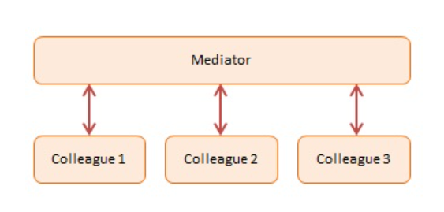
Continued...
DOM event bubbling and event delegation:
If all subscriptions in a system are made against the document rather than individual nodes, the document effectively serves as a Mediator. Instead of binding to the events of the individual nodes, a higher-level object is given the responsibility of notifying subscribers about interaction events.
Diagram:

Slide 5
Mediator Design Pattern Participants
Mediator -- In example code: Chatroom
defines an interface for communicating with Colleague objects
maintains references to Colleague objects
manages central control over operations
Colleagues -- In example code: Participants
objects that are being mediated by the Mediator
each instance maintains a reference to the Mediator

Slide 6
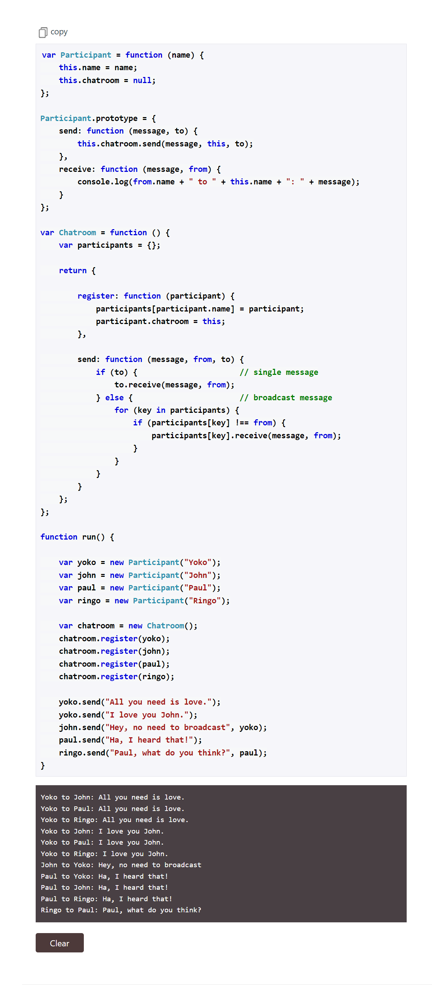

Slide 7
Useful Resources
https://www.patterns.dev/posts/classic-design-patterns/#mediatorpatternjavascript
https://www.dofactory.com/javascript/design-patterns/mediator

